Slide 1
Seeed Line Finder

Slide 2
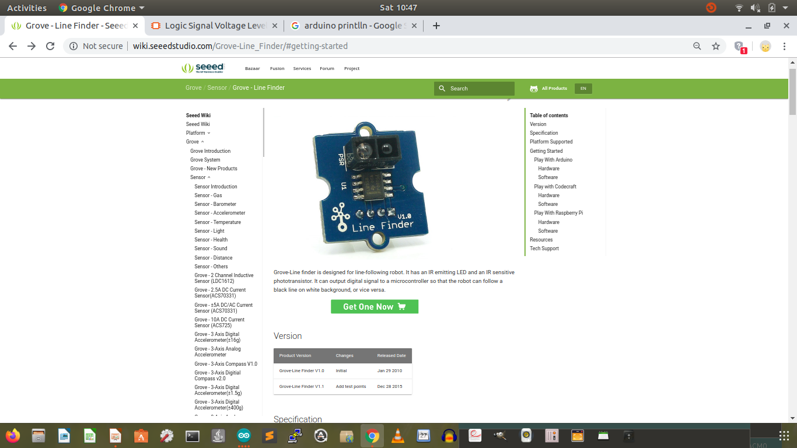
http://wiki.seeedstudio.com/Grove-Line_Finder/#getting-started

Slide 3
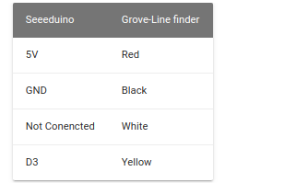
D3 (Input mode for UNO)
D3 = 1 (black surface), 0 (white line)

Slide 4
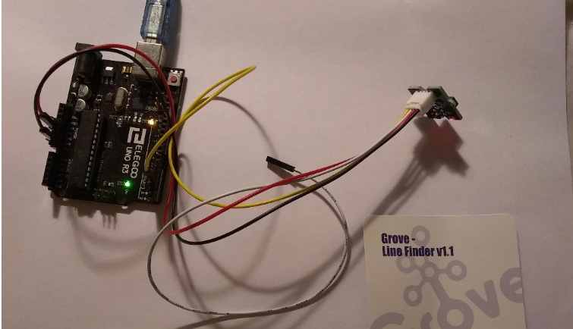
Connection (D3 Yellow, 5V, Red, GND Black, NC White)

Slide 5
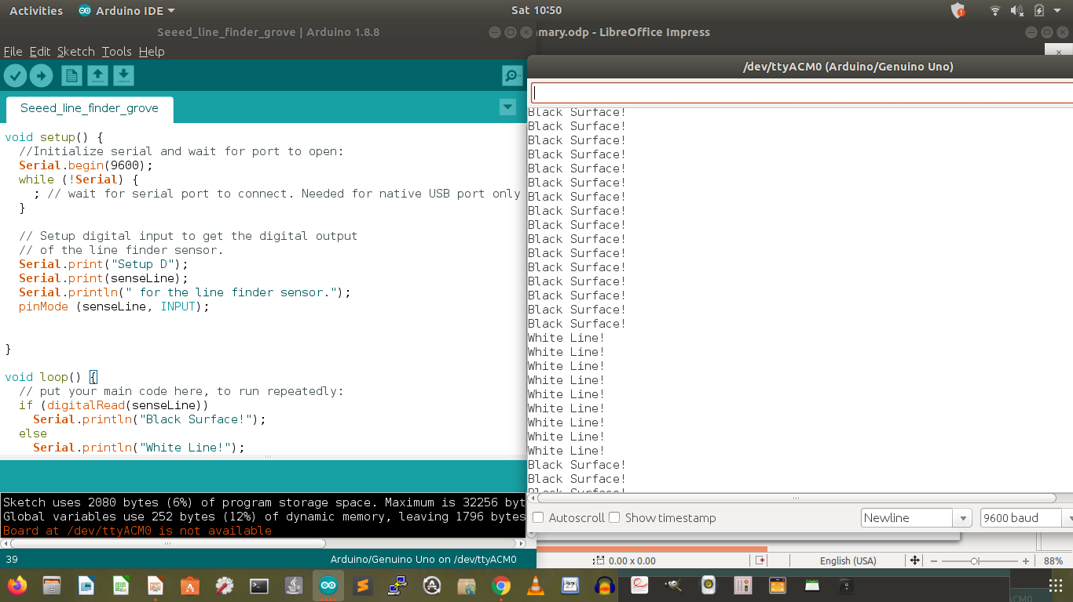
Polling D3 Continuously

Slide 6
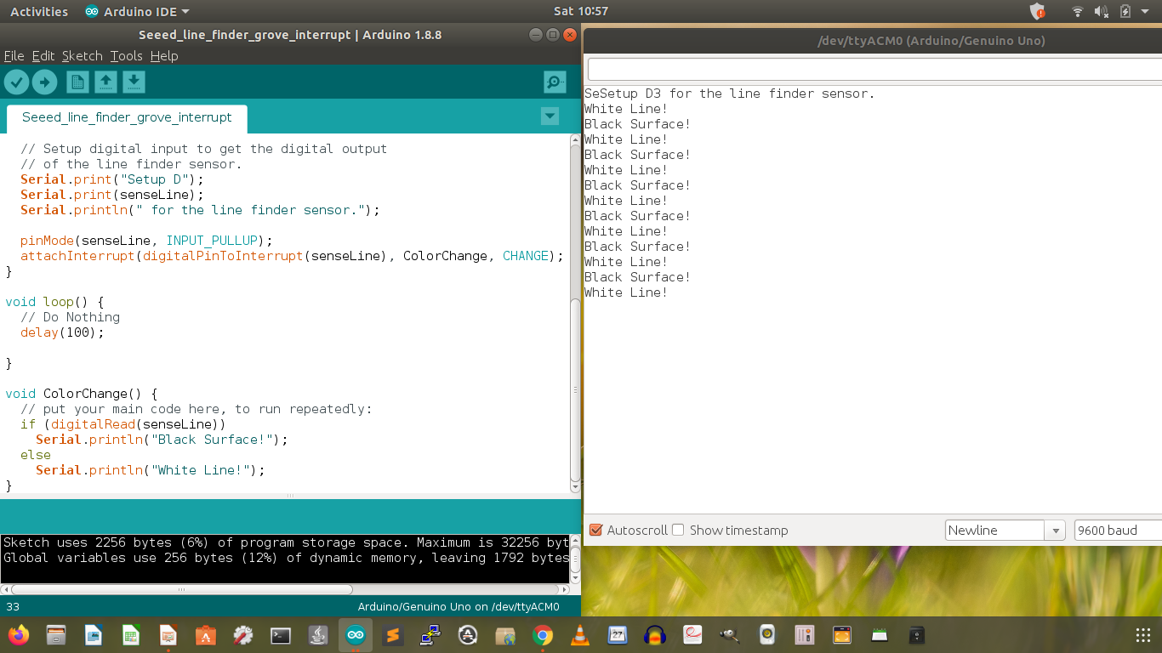
Use the interrupt to free CPU to do other important tasks.

